Slide 1
Computer Architecture I
CS-GY-6133
Topic: Caches
Instructor: Siddharth Garg

Slide 2
5 Stage Pipeline (with support for load/store)
Two forwarding paths
Same destination register in both forwarding paths? Pick data from EX-EX forwarding path
Forwarding Control Logic
R[rd] from prior to prior instruction
R[rd] from prior instruction
Flip-Flop
ID/RF
(Decoder, RF)
Flip-Flop
EX
(ALU)
Flip-Flop
Flip-Flop
WB
(RF)
Flip-Flop
Flip-Flop
IF
(PC, Imem)
MEM
(Dmem)
CLK
CLK
CLK
CLK
CLK
CLK

Slide 3
RAW Hazards: Add-Load Dependency
t0
t1
t2
t3
t5
Time
IF
ID/RF
EX
MEM
WB
add $1, $2, $3
Read $1, $2
R[$1] + R[$2]
nop
Write $3
IF
ID/RF
EX
MEM
WB
lw $3, $4, imm
Read $3
Addr = R[$3] + SgnImm
Load from Addr
Write $4
EX-EX Forwarding
Instructions

Slide 4
RAW Hazards: Add-Load Dependency
t0
t1
t2
t3
t5
Time
IF
ID/RF
EX
MEM
WB
add $1, $2, $3
Read $1, $2
R[$1] + R[$2]
nop
Write $3
IF
ID/RF
EX
MEM
WB
add $7 $8, $9
Read $7, $8
R[$7] + R[$8]
nop
Write $9
IF
ID/RF
EX
MEM
WB
lw $3, $4, imm
Read $3
Addr = R[$3] + SgnImm
Load from Addr
Write $4
Instructions
MEM-EX Forwarding

Slide 5
RAW Hazards: Load-Add Dependency
t0
t1
t2
t3
t5
Time
IF
ID/RF
EX
MEM
WB
lw $3, $4, imm
Read $3
Addr = R[$3] + SgnImm
Load from Addr
Write $4
IF
ID/RF
EX
MEM
WB
add $4, $5, $6
Read $4, $5
R[$4] + R[$5]
nop
Write $6
Will this work?
Solution: Stall the pipeline
Instructions

Slide 6
RAW Hazards: Load-Add Dependency
t0
t1
t2
t3
t5
Time
IF
ID/RF
EX
MEM
WB
lw $3, $4, imm
Read $3
Addr = R[$3] + SgnImm
Load from Addr
Write $4
IF
ID/RF
EX
EX
MEM
WB
add $4, $5, $6
Read $4, $5
R[$4] + R[$5]
R[$4] + R[$5]
nop
Write $6
Solution: Stall the pipeline
Instructions

Slide 7
RAW Hazards: Load-Add Dependency
t0
t1
t2
t3
t5
Time
IF
ID/RF
EX
MEM
WB
lw $3, $4, imm
Read $3
Addr = R[$3] + SgnImm
Load from Addr
Write $4
IF
ID/RF
EX
MEM
WB
add $7 $8, $9
Read $7, $8
R[$7] + R[$8]
nop
Write $9
IF
ID/RF
EX
MEM
WB
add $4, $5, $6
Read $4, $5
R[$4] + R[$5]
nop
Write $6
Instructions
MEM-EX Forwarding

Slide 8
RAW Hazards: Load-Store Dependency (NEW)
t0
t1
t2
t3
t5
Time
IF
ID/RF
EX
MEM
WB
lw $3, $4, imm
Read $3
Addr = R[$3] + SgnImm
R[$4] = Mem[Addr]
Write $4
IF
ID/RF
EX
MEM
WB
sw $5, $4, imm
Read $5
Addr = R[$5] + SgnImm
Mem[Addr] = R[$4]
Write $9
MEM-MEM Forwarding (new)
Instructions

Slide 9
5 Stage Pipeline (with support for load/store)
Three forwarding paths
EX-EX, MEM-EX, MEM-MEM
Forwarding Control Logic
R[rd] from prior to prior instruction
Flip-Flop
ID/RF
(Decoder, RF)
Flip-Flop
EX
(ALU)
Flip-Flop
Flip-Flop
WB
(RF)
Flip-Flop
Flip-Flop
IF
(PC, Imem)
MEM
(Dmem)
CLK
CLK
CLK
CLK
CLK
CLK

Slide 10
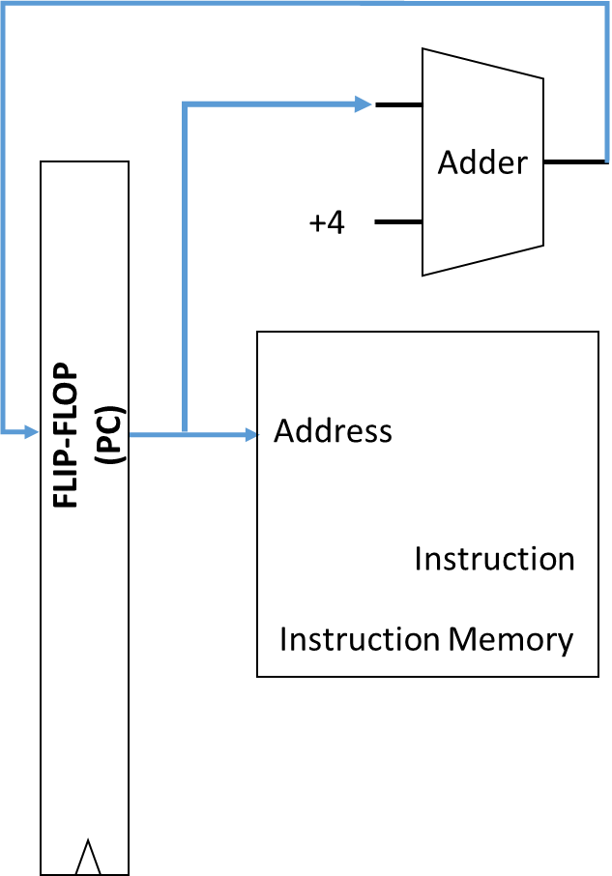
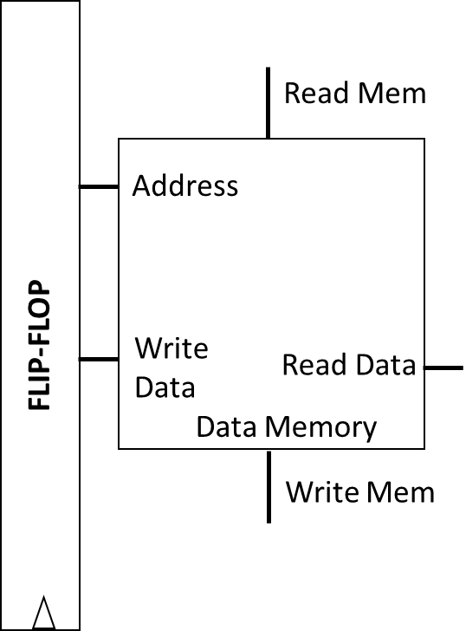
5-Stage Pipeline
Flip-Flop
ID/RF
(Decoder, RF)
Flip-Flop
EX
(ALU)
Flip-Flop
Flip-Flop
WB
(RF)
Flip-Flop
Flip-Flop
IF
(PC, Imem)
MEM
(Dmem)
CLK
CLK
CLK
CLK
CLK
CLK
How are Imem and Dmem implemented?
Note: simplified pictures of IF and MEM stages

Slide 11
Memory System
Processor
Flip-Flop
ID/RF
(Decoder, RF)
Flip-Flop
EX
(ALU)
Flip-Flop
Flip-Flop
WB
(RF)
Flip-Flop
Flip-Flop
CLK
CLK
CLK
CLK
CLK
CLK
Memory Controller
Main Memory
Dynamic Random Access Memory (DRAM)
(Unified instruction and data memory)

Slide 12
DRAM Details
3.6 GHz Pentium 4
Flip-Flop
ID/RF
(Decoder, RF)
Flip-Flop
EX
(ALU)
Flip-Flop
Flip-Flop
WB
(RF)
Flip-Flop
Flip-Flop
CLK
CLK
CLK
CLK
CLK
CLK
Memory Controller
Main Memory
Memory capacity: 4GB
Access Latency: 50 ns/word = ?? Clock cycles/word
= 50 ns / (1/3.6) ns = 180 cycles

Slide 13
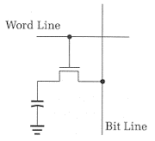
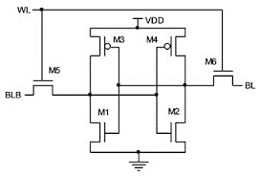
Memory Technologies
 | DRAM | SRAM (512 KB) | SRAM (4 MB)
Cell | 1 Transistor, 1 Capacitor (1T-1C) | 6 Transistor (6T) | 6 Transistor (6T)
Density (bits/um²) | High | Low | Low
Access Latency (ns) | Large | Small | Medium

Slide 14
Memory Hierarchy
Cache = “temporary storage space”
Instead of slow off-chip access to large DRAM, store frequently used data in on-chip SRAM cache
Hierarchy:
L1 Cache: small (32 KB), very fast (typically 1 clock cycle)
L2 Cache: larger (1 MB), slower (10s of nsecs)
L3 Cache: even larger ….
Main Memory: 4GB, 100s of nsecs
Decoder, RF, EX
CPU
SRAM
L1 Cache
SRAM
L2 Cache
DRAM Main Memory

Slide 15
Locality
Decoder, RF, EX
CPU
Temporal locality: if you’ve accessed some data, you’ll likely access it again in the near future
Same instructions are repeatedly accessed within loops
For example the loop counter
Spatial locality: if you’ve accessed some data, you’ll likely access nearby data
Array accesses
Instruction are accessed in sequential order
SRAM
L1 Cache
SRAM
L2 Cache
DRAM Main Memory

Slide 16
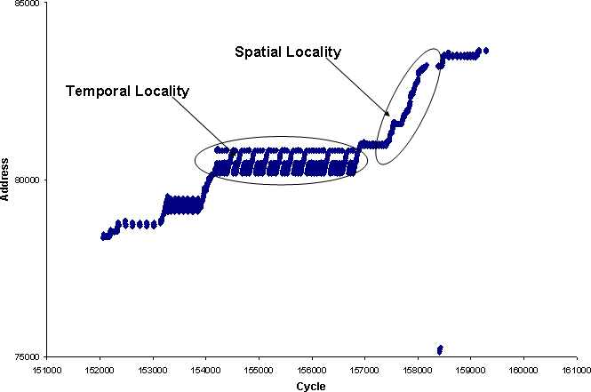
Access Pattern Exhibiting Locality
http://www.eetimes.com/document.asp?doc_id=1275470

Slide 17
Cache Organization
Caches store data in chunks of “cache blocks”
Access to a cache returns an entire cache block
A block can be as small as 1 byte, but can be larger (example: 4 bytes)
Where does a block go when it is fetched into cache? (Placement)
How do we know if a block already exists in the cache? (Identification)
Which block should we kick out if there isn’t enough room? (Replacement)
32 KB cache
1 Byte cache block
i.e., 32768 blocks
32 bit address
from CPU

Slide 18
Direct Mapped Cache
Assume 32 KByte cache with a 1 Byte cache block
1 Byte = 8 bits
Block 0
Address 0, 32768, 2*32768, …
Block 1
Address 1, 32769, 2*32768+1, …
Block 2
Address 2, 32770, 2*32768+2, …
32 bit address
from CPU
Block 32767
Address 32767, 65535, …

Slide 19
Direct Mapped Cache: Placement
Each block in the cache has a log₂(32768) = 15 bit “index”
Index
Block 0
Address 0, 32768, 2*32768, …
32 bit address
from CPU
Block 1
Address 1, 32769, 2*32768+1, …
Block 2
Address 2, 32770, 2*32768+2, …
Index
(15 bits)
15 LSBs of address are used to look up (index) into the cache
Block 32767
Address 32767, 65535, …

Slide 20
Direct Mapped Cache: Identification
32 bit address
Data Array
(8 bits)
Tag Array
(17 bits)
Tag
(17 bits)
Index
(15 bits)
Block 0
Tag 0
Addr 0
0…………………….00
0….00
Block 1
Tag 1
Addr 32768
0…………………….01
0….00
Block 2
Tag 2
How do we know which block of data is stored?
Addr ….
1…………………….11
0….00
Block 32767
Tag 32767

Slide 21
Direct Mapped Cache: Replacement
32 bit address
Data Array
(8 bits)
Tag Array
(17 bits)
Tag
(17 bits)
Index
(15 bits)
Data[0]
0…………… 00
Data[32768]
Tag 0
Block 0
0…………… 01
Access 1
0…………………….00
0….00
Miss
Block 1
Tag 1
Data[32769]
0…………… 00
Access 2
0…………………….00
0….00
Hit
Block 2
Tag 2
Access 3
0…………………….01
0….00
Miss
Access 4
0…………………….00
0….01
Miss
Block 32767
Tag 32767

Slide 22
Direct Mapped Cache: Replacement
32 bit address
Data Array
(8 bits)
Tag Array
(17 bits)
Valid
(1 bit)
Tag
(17 bits)
Index
(15 bits)
Data[0]
1
Data[32768]
Tag 0
Block 0
0…………… 00
0
Access 1
0…………………….00
0….00
Miss
0
Block 1
Tag 1
1
Data[32769]
0…………… 01
Access 2
Block 2
Tag 2
0…………………….00
0….00
Hit
Access 3
0…………………….01
0….00
Miss
Block 32767
Tag 32767
0

Slide 23
Cache Operation
Data Array
(8 bits)
Tag Array
(17 bits)
Valid
(1 bit)
Address (32 bits)
Tag
(17 bits)
Index
(15 bits)
Block 0
Tag 0
V 0
0
Block 1
Tag 1
0
V 1
Block 2
Tag 2
V 2
Block 32767
Tag 32767
V..
1
=
&
0
0
MISS
Output Data if HIT
1
HIT

Slide 24
Alternative Placement
Assume 32 KByte cache with a 1 Byte cache block
1 Byte = 8 bits
Use 15 MSBs of address to determine index
Consider following stream of accesses:
Addr 0, Addr 1, Addr 0, Addr 1,..
“Conflict Misses”
Block 0
Address 0, 1, 2, 3, …..
Block 1
Address 32678, ….
Block 2
Bad Idea!
Block 32767

Slide 25
Set Associative Caches
Direct mapped caches can have high conflict miss rate
Each address maps to a unique location in the cache
Assume addresses A and B with same index bits
Sequence: A, B, A, B, A….. results in 100% cache miss rate!
Set-associative cache: each address can map to N different locations in the cache!
“N-way” set associative cache
2-way set associate cache has ~0% cache miss rate for sequence A, B, A, B …

Slide 26
2-Way Set Associative Cache
2-way set-associative 32 KB cache with 1 Byte blocks
Data Array
(8 bits)
Tag Array
(? bits)
Valid
(1 bit)
Data Array
(8 bits)
Tag Array
(? bits)
Valid
(1 bit)
Set 0
Set 1
Set 16384
Way 0
Way 1

Slide 27
Placement
Tag
(? bits)
Index
(14 bits)
Tag
(18 bits)
Index
(? bits)
Data mapped to a unique set but can be placed in either way
Data Array
(8 bits)
Tag Array
(? bits)
Valid
(1 bit)
Data Array
(8 bits)
Tag Array
(? bits)
Valid
(1 bit)
Set 0
Set 1
Set 16384
Way 0
Way 1

Slide 28
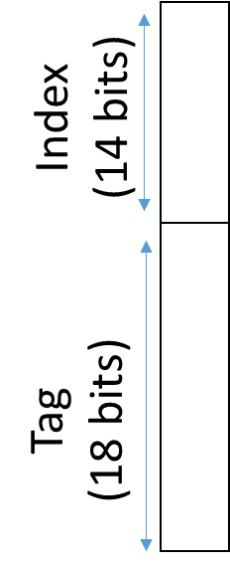
Identification
Way 0
Way 1
Data Array
(8 bits)
Tag Array
(18 bits)
Valid
(1 bit)
Data Array
(8 bits)
Tag Array
(18 bits)
Valid
(1 bit)
=
&
=
&
HIT?
HIT?

Slide 29
Replacement
(Addresses A, B, C map to same set)
Way 0
Way 1
Data Array
(8 bits)
Tag Array
(18 bits)
Valid
(1 bit)
Data Array
(8 bits)
Tag Array
(18 bits)
Valid
(1 bit)
Data[A]
Tag[A]
1
Data[B]
Tag[B]
1
Sequence: A B B A A A A C
Where should C go?
M
M
H
H
H
H
H
M

Slide 30
Least Recently Used (LRU)
Way 0
Way 1
Data Array
(8 bits)
Tag Array
(18 bits)
Valid
(1 bit)
Data Array
(8 bits)
Tag Array
(18 bits)
Valid
(1 bit)
Data[A]
Data[B]
Tag[B]
1
Tag[A]
1
Data[C]
Tag[C]
Evicted!
Sequence: A B B A A A A C
Replace least recently used block
M
M
H
H
H
H
H
M

Slide 31
Implementing LRU
Way 0
Way 1
Data Array
(8 bits)
Tag Array
(18 bits)
Valid
(1 bit)
Data Array
(8 bits)
Tag Array
(18 bits)
Valid
(1 bit)
MRU
(1 bit)
Tag[B]
1
1
Data[A]
0
Tag[A]
1
Data[B]
0
Sequence: A B B A A A A C
LRU = NOT MRU
M
M
H
H
H
H
H
M

Slide 32
Practical LRU Implementation
LRU is hard to implement in hardware for N>2
Keep track of all possible N! orderings of N ways
A linked list in which the head points to MRU and tail points to LRU
Example: N=4; 4 x 2 bits = 8 bits per cache set and extra logic to update list on every access
Alternative policies that are more hardware friendly
NOT MRU: same as LRU for N=2, requires only log(N) bits, easy update
Hierarchical: for N=4, divide ways into 2 groups of 2 ways

Slide 33
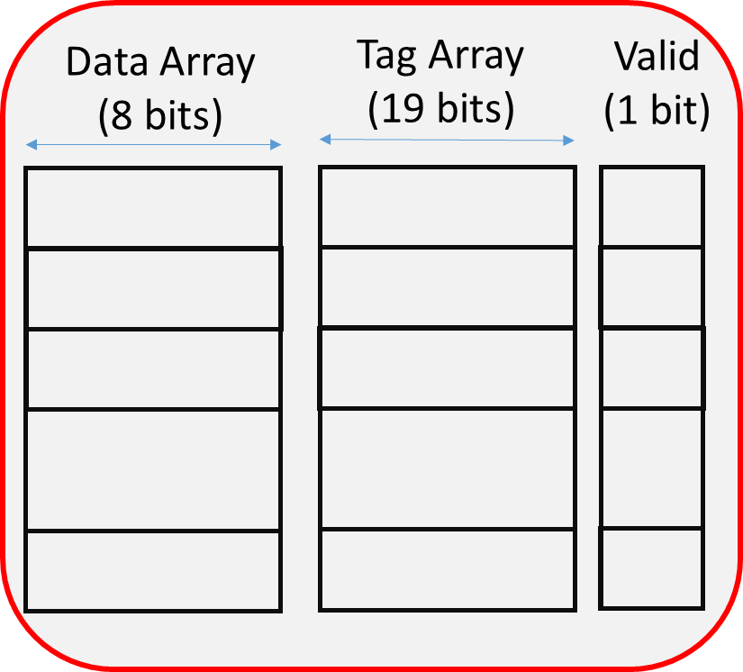

Hierarchical LRU Implementation
MRU Way
(G0)
MRU Way (G1)
Way 0
Way 1
Way 2
Way 3
MRU Grp
A
B
C
D
Group 0
Group 1
Sequence | A | C | D | B | A | A | E
MRU Grp | 0 | 1 | 1 | 0 | 0 | 0
MRU Way (G0) | 0 | 0 | 0 | 1 | 0 | 0
MRU Way (G1) | - | 2 | 3 | 3 | 3 | 3
Which block is evicted?

Slide 34
Hierarchical LRU Implementation
MRU Way
(G0)
MRU Way (G1)
Way 0
Way 1
Way 2
Way 3
MRU Grp
A
B
C
D
Group 0
Group 1
Sequence | A | C | D | B | A | D | E
MRU Grp | 0 | 1 | 1 | 0 | 0 | 1
MRU Way (G0) | 0 | 0 | 0 | 1 | 0 | 0
MRU Way (G1) | - | 2 | 3 | 3 | 3 | 3
Which block is evicted?
Not the true LRU block!

